Slide 1
The road to ethical hacking
CyberSecurity-Discussion : Basics 02: Non-Technical SE
October 11, 2018
Tribe Mentality

Slide 2



Oxytocin & Dopamine: Trust and Emotions
Pigeon Scam
Giving up a sum of money to receive larger amounts.
Oxytoxin: Make target feel part of the ingroup.
Example: Dress like them, talk like them.
Dopamine: Reward
Offer larger sum of moneys,
Note: Make them work for it.
Make Target Happy. Not Mad.
Angry = ‘Thinking’, Happy = ‘Not Thinking’
CounterMeasures: When someone around you always makes you happy, be skeptical.
Rick And Morty : Social Engineering

Slide 3

Sense of urgency
“Do you have a second”
Not a constraint.
Waiting in line
True time constraint.
Email Subject: “Urgent” , “Today Online”,
“Limited Time” , “Act Now”
At face value, you know to be skeptical, but this has been proven to work.
Technical: Use Kali Linux

Slide 4

Approaching others
People want to feel safe
Are you a threat?
Body Language
Hardest part of social engineering.
Have a conscious.
Sympathy is vital to human interactions.
Vishing – Voice phishing

Slide 5
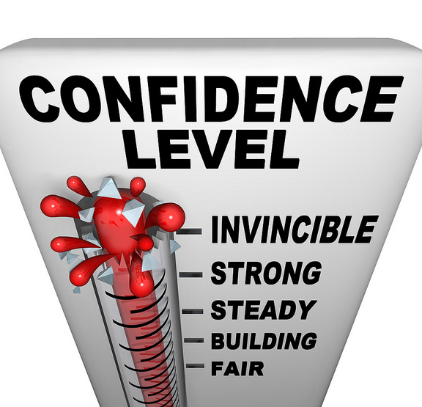
um, like, and
A social Engineers demise starts when they use “um, like, and”
Do not stutter, speak slowly about subjects you are not familiar about.
Do not speak to slow. This shows lack of knowledge or confidence.
Do not overconfident.
Use vernacular carefully.
Rhythm, Speed, Volume, Pitch
Pre-Texting
Let the target lead, use their RSVP

Slide 6

Sympathy & Validation
Validating your target
Be very careful. Determine the level of trust.
Understand culture.
Make yourself vulnerable. (Suspend your ego)
Some level of knowledge, let target take lead.
Medium critical.
Ask how, why, and when.
Do not think of your next line.
Provide a name. (Buyers remorse)

Slide 7
Principle of reciprocity
A social engineer is generous.
The value of gift is determined by the receiver.
It is a social norm to give something back.

Slide 8
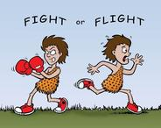
Fight or Flight: Social Engineering
Do not fight.
You want to leave your target feeling better than before they had encountered you.
Understand your feelings, if you feel good so does the target.
If you feel awkward or negative emotions, back away.
Take Flight!! Winning is not important.
Be passive, being aggressive is very rare.
Happy = “Not thinking” , Mad = “thinking”
Do not let your target think.

Slide 9

Training Lab
What principle?
Apply it to your family or friends.
Start with a compliment.
Ask about life or events.
Listen, do not think of what to say next. Just listen.
Determine what works and does not. What are you good at?

Slide 10
Out of sight out of mind
Many of the principles outline may seem intuitive.
Are they?
Next time someone approaches you or when you are reading an email, the principles and techniques outline here will subconsciously be there.
The mere fact that you heard of this techniques makes you much less vulnerable.
Example: Language
English words help you create ideas, but it is difficult to pinpoint exactly where or at what point you learned them.
In class you learn but most of the time you feel as if you do not know anything. When taking the exam knowledge become apparent.
Be Skeptical! Stay relatively angry.
DOCUMENT EVERYTHING

